Slide 1
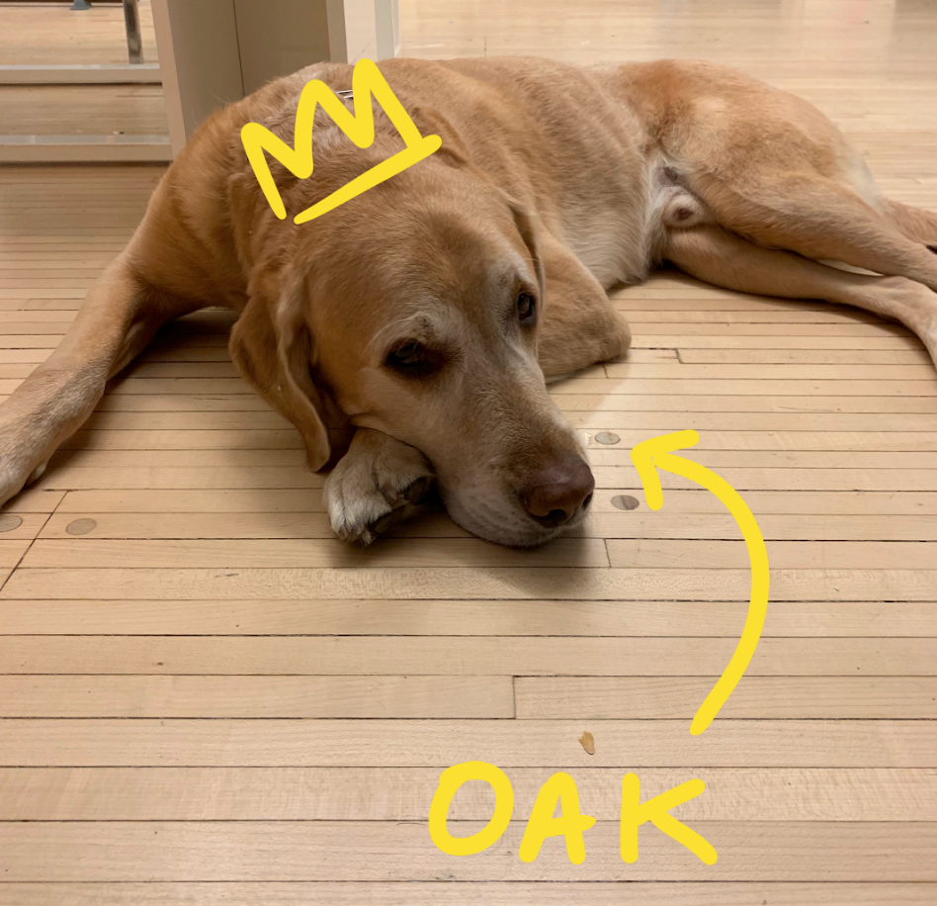
Light Tag
Light Tag
Laser tag for all abilities
Team TOAK
@ ChairJam 2019

Slide 2
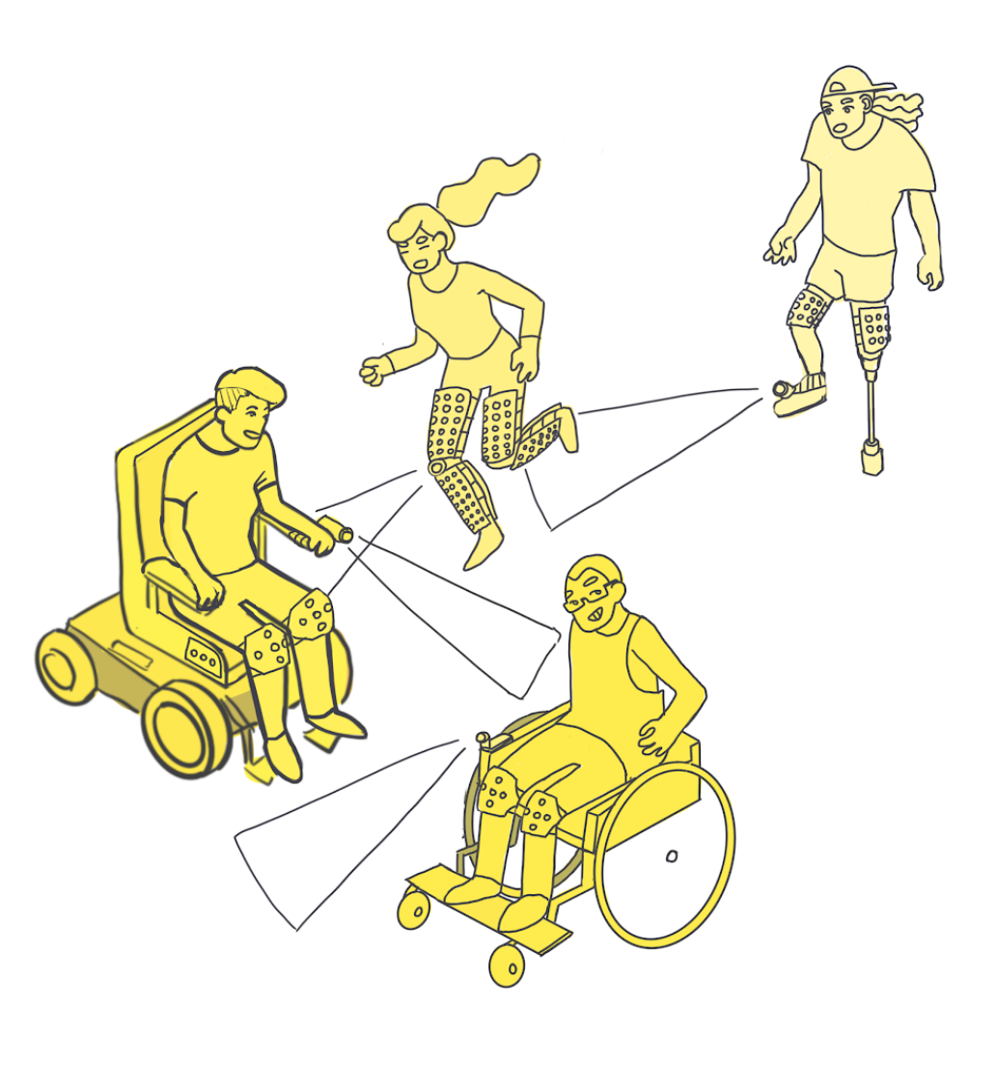
How to Play
1
Gear up!
2
Keep moving!
3
Stay within game bounds.
4
Point laser at target to tag.
5
No retag!

Slide 3
Design Goals
1
3
Flexibility of interaction for adaptation to change.
Light manipulation as a form of communication.
2
4
Access to smartphone allowing for easy adjusting.
Suggested builds allowing for customization for each player.

Slide 4
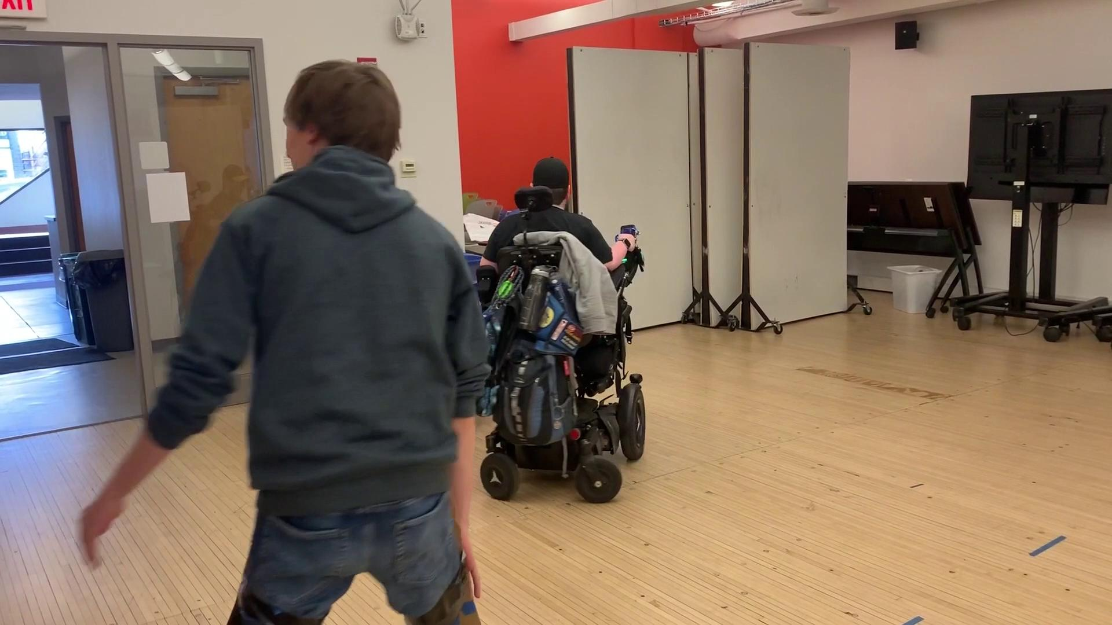
Playtesting
3
Groups
Powerchair, manual chair and able-bodied users

Slide 5
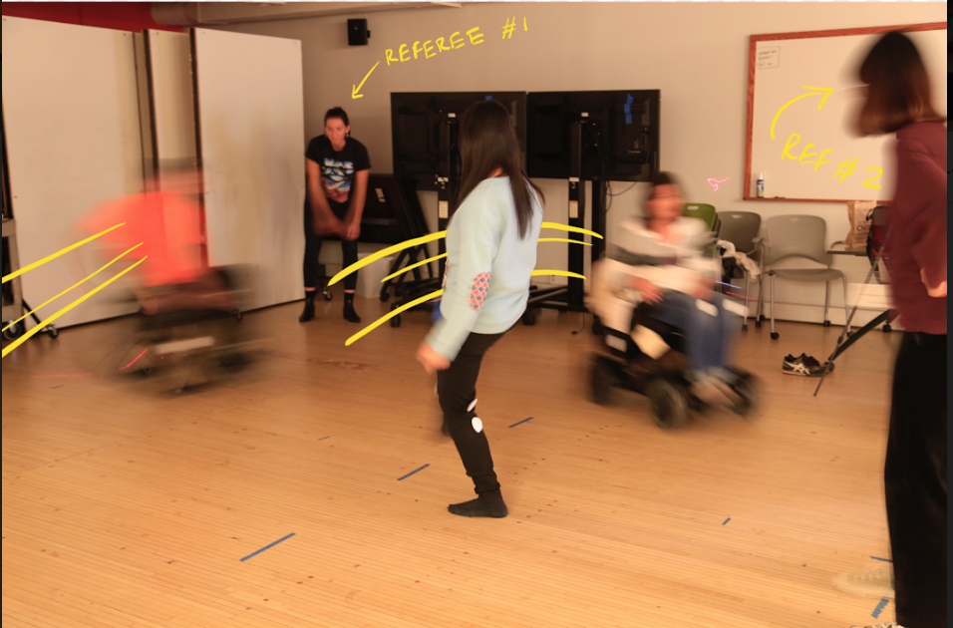
Findings from
Playtesting
Find the fun!
Flexibility to find balance in terms of space, players, equipment, etc. in order to gain a playful experience.

